Slide 1

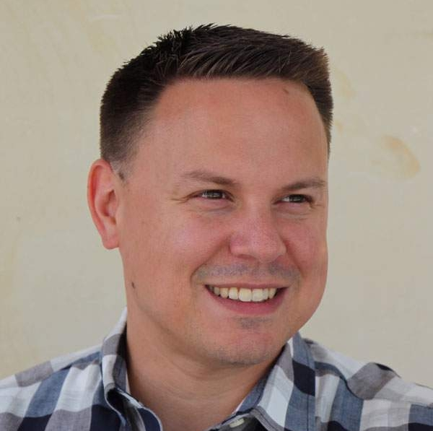

Getting to 100:
Fixing Your Anthology Ally Errors
Damian Sian
Adjunct professor
School of Communication and Information, Library Sciences
Rutgers University – New Brunswick

Slide 2
Agenda
Background and housekeeping
Presenter introduction
Workshop structure
Scope of the challenge and technology limitations
Hands-on activities
All wrong

Slide 3
Section one: Presenter introduction
Who the hell does this guy think he is anyway?

Slide 4




Work history
Damian has worked in the accessibility field for 14 years for institutions such as Princeton University and Prudential Financial.
He teaches an Introduction to Web Accessibility course at Rutgers University on the New Brunswick campus.
Damian currently serves as a Principal Engineering Program Manager at Adobe on the Product Equity team.

Slide 5

Credentials
Damian has just about all the accessibility credentials one can obtain from the International Association of Accessibility Professionals (IAAP).
Certified Practitioner of Accessibility Core Competencies (CPACC)
Web Accessibility Specialist (WAS)
Certified Practitioner of Web Accessibility (CPWA)
Accessible Document Specialist (ADS)
Working on a UX Design accessibility certification IAAP and curriculum with TeachAccess.

Slide 6
Background in accessibility
Front-end development (HTML and mostly React)
Document accessibility (30 years in communications industry)
Automated and manual testing (including building tools and process)
Triage and remediation with globally distributed teams
Assistive technologies (screen reader and voice control)
Compliance, governance, and resource for legal
Process and policy creation and enforcement
Enablement and training (corporate adult learning)
Curriculum and certification development

Slide 7
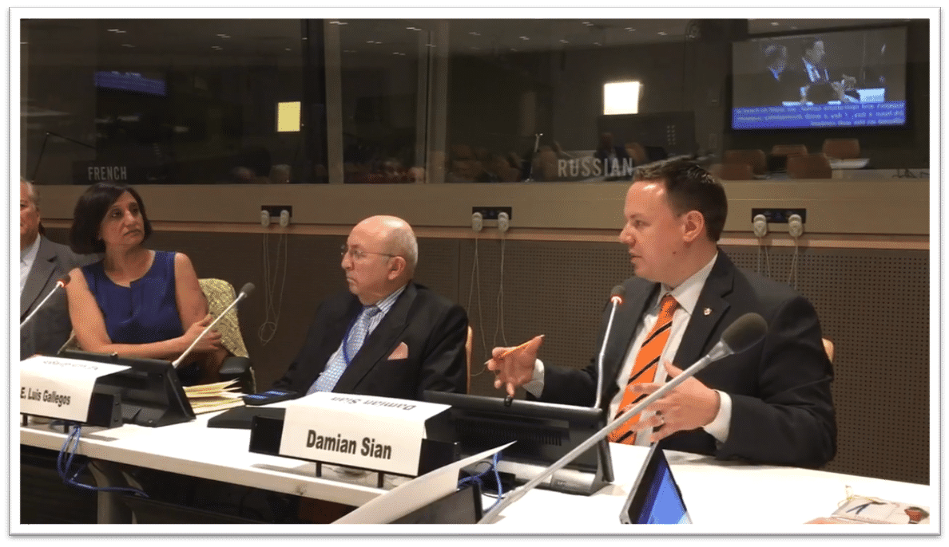
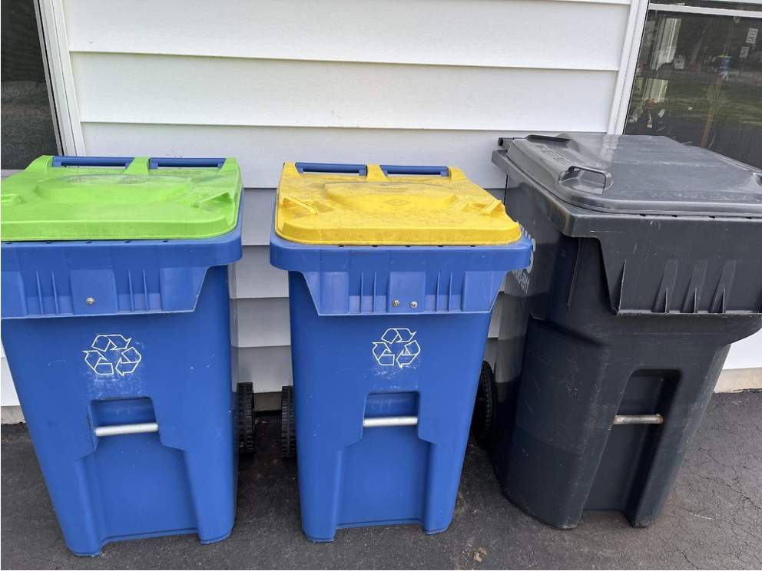
Two important highlights
Speaking at the United Nations was pretty cool.
But my recycling bins are by far my proudest achievement.

Slide 8
Section two: Workshop structure
How we’ll facilitate our interactive this interactive journey.

Slide 9
Sample files
Download the zip package here, or go the website and download the samples there, your choice.
Wherever possible, a file is provided for you to place into the Canvas LMS.
We will trigger automated errors and learn how to resolve them.
We will also expose where automated testing is lacking.
Damian will demonstrate assistive technology throughout.
You are not required to use assistive technology to follow along.
You will need MS Word, MS PowerPoint, and Acrobat Professional if you intend to follow along with all the topics today.
You will need access to an instance of Canvas if you intend to follow along (a test course would be the best if you have one).

Slide 10
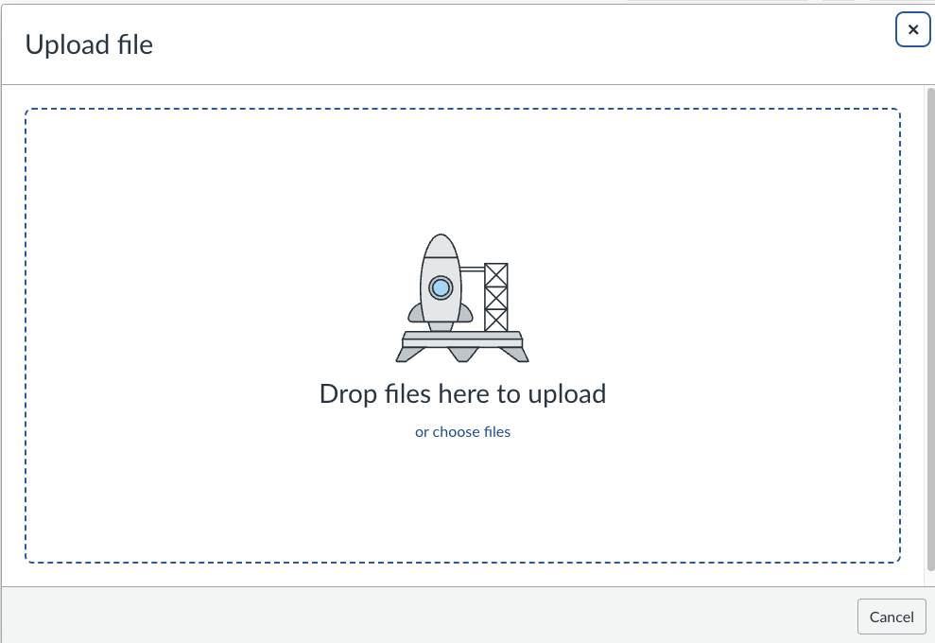
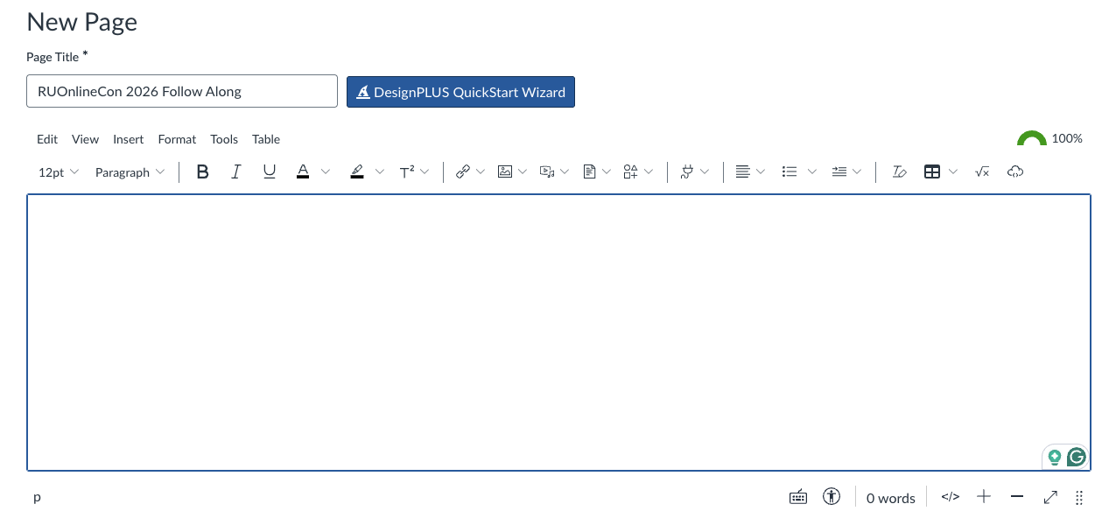
Following along Canvas
File upload function
Rich Content Editor (RCE)
You’re encouraged to create a new Page in your Canvas instance where we can play and make a mess.
You’re encouraged to create a folder in your files section of Canvas, so you don’t muddy your existing file structure in your course.

Slide 11
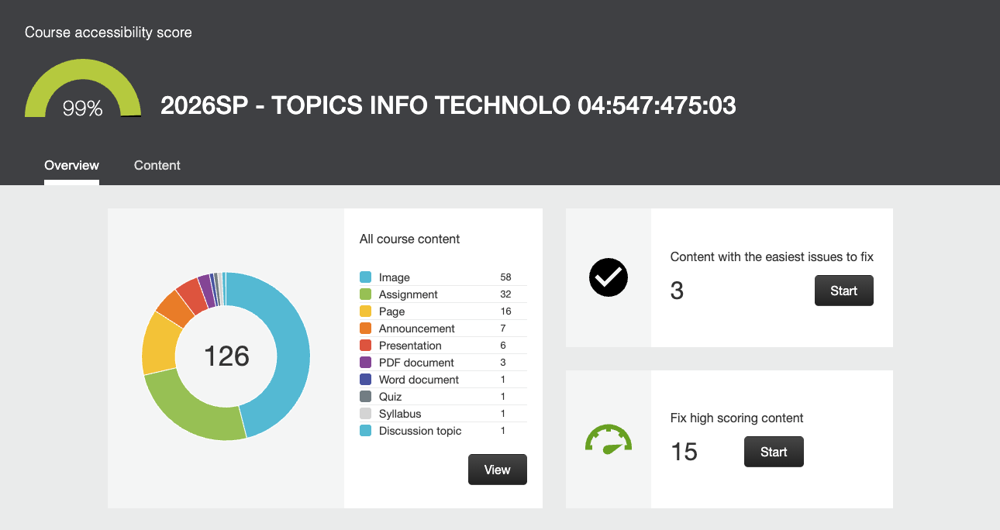
Accessibility dashboard
We will be looking at the course accessibility score and dashboard in Canvas as well.

Slide 12
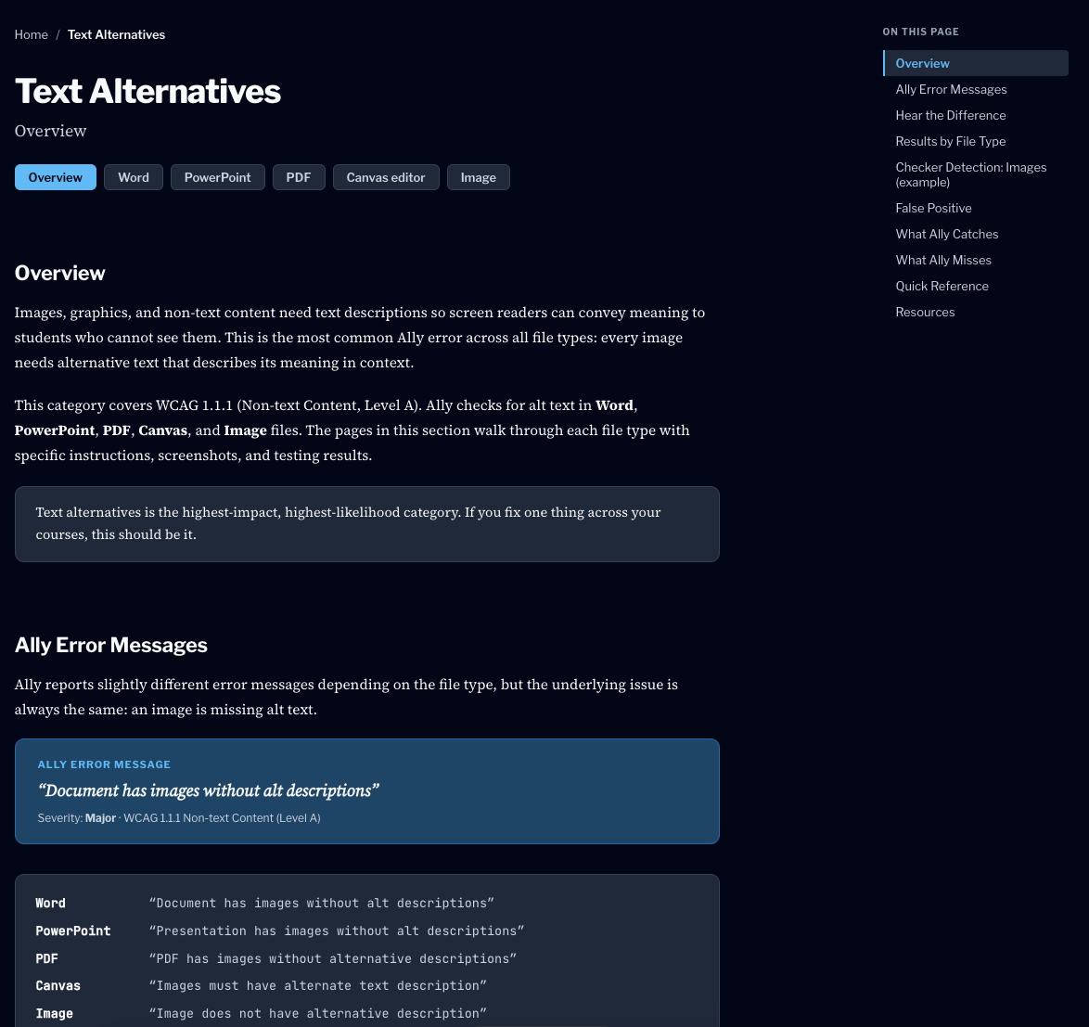
Website reference resource
In addition to this deck, a website is available to you that is a 1:1 match of the content in this workshop complete with:
The sample files
Explanations of the tests
Shortcomings of Ally
Impact on students with disabilities
Example outputs from screen readers
Step-by-step guides on how to fix issues as shown here today

Slide 13
Section three: Scope of the challenge
The scope and limitations of automated testing.

Slide 14
Covered in section three
To come.
What is Ally actually testing?
What is it missing?
What is it getting wrong (false positives)?
Tractibility

Slide 15
What is Ally actually testing?
Content type | Number of tests
Rich content editor | 54
Image files | 4
PDF documents | 14
Word documents | 11
PowerPoint presentations | 8
Total | 91
Source: Anthology help accessibility checklist

Slide 16
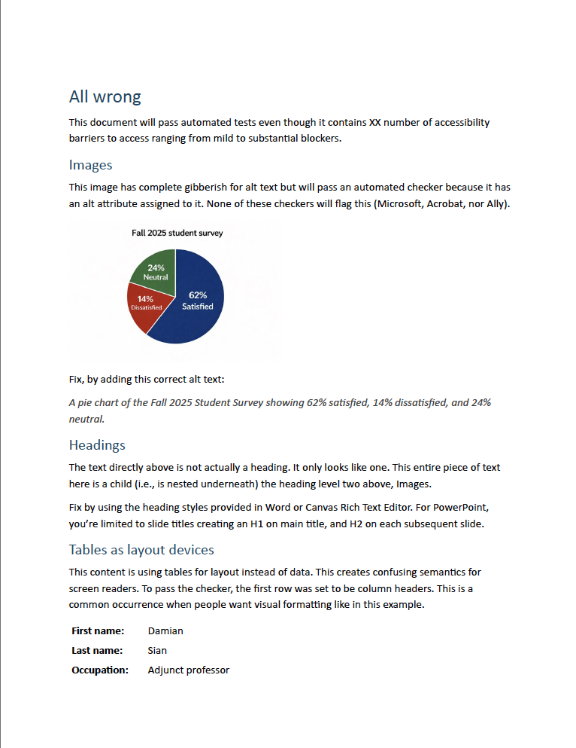
All wrong demo
Take your file and follow along with me.
Add the All-Wrong.pdf to the files section of a Canvas course and let’s observe the results.

Slide 17
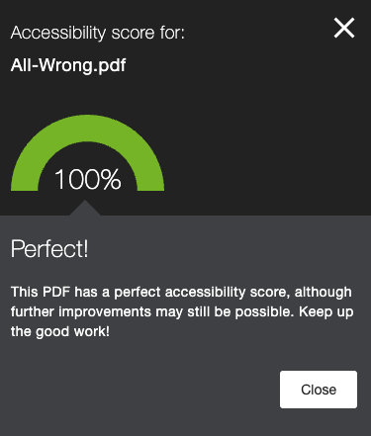
All wrong demo – Results
We get to 100%! Woo hoo!
But the to document is fundamentally inaccessible.
Every aspect of the document is designed to spoof automated testers.
But what about the other way around – could we have a doc fully accessible and have it fail for accessibility?
Let’s find out!
Patently false statement.

Slide 18
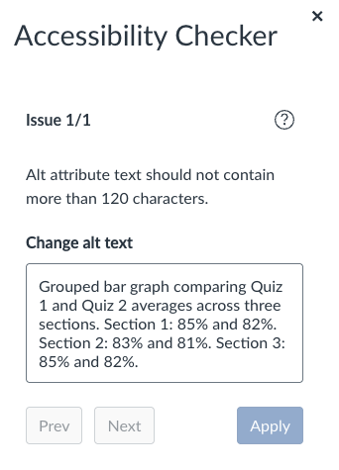
False positives
120-character limit on alt text
Occurs in RCE, not in the Dashboard
Image contrast
Occurs in Dashboard, not in the RCE
Interestingly, the image here causes a text contrast error in Ally.
Table captions
Occurs in RCE, not in the Dashboard
Open the Canvas page from the Commons area.

Slide 19
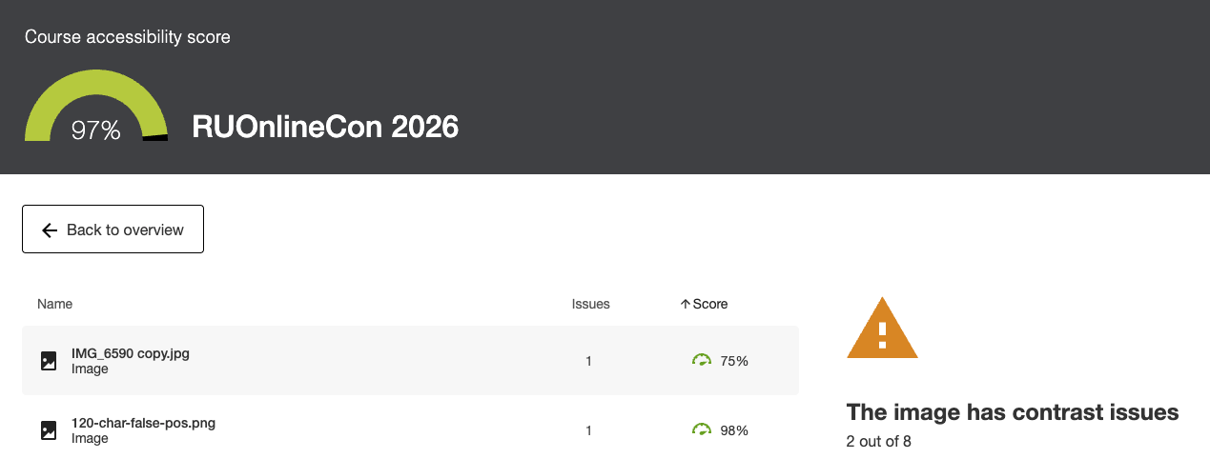
Impact to score only, not students
I have yet to see a single instance where the tool has correctly identified contrast issues in an image. These false positives can safely be ignored in every case I’ve reviewed.

Slide 20
Section three: Fixing and avoiding issues
The best way to fix an issue is to not create the issue in the first place.

Slide 21
To come

